Slide 1
Introduction To F#
Hampton Roads User Group
July 2016
Jamie Dixon

Slide 2
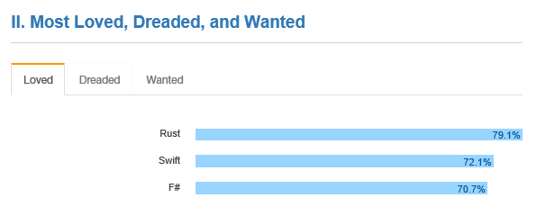

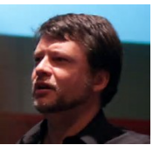
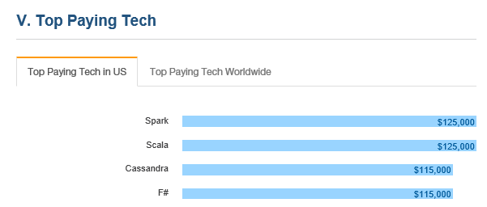
Why you should care?
Notes:
your next language should be F# - Uncle Bob Martin
you need to think differently - F# is a great choice - Andy Hunt
Make more money - stack overflow
Have more fun - me

Slide 3
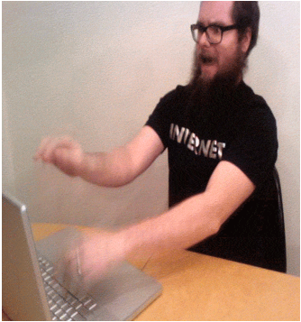

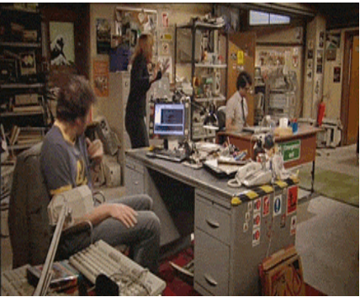




Learning a new language is hard
Actual Silverlight Development
Notes:
javascript was good idea
Is it worth the pain?
Will I write better code?
Will I be faster to market?
What if people use it as an excuse for failure? What if Microsoft pulls the plug?

Slide 4
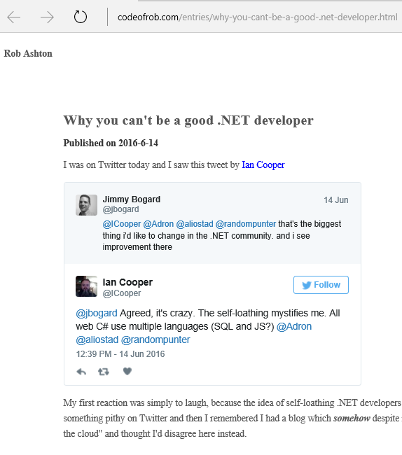
Is It The Fate of .NET?
There is a reason this mentality exists and it isn't one of self loathing. The reason why people "leave" .NET is because it is impossible to be a good .NET developer. To work in a development shop with a team is to continually cater for the lowest common denominator of that team and the vast majority of software shops using .NET have a whole lot of lowest common denominator to choose their bad development decisions for.

Slide 5



Your Most Common Bugs
Notes:
improper state (null ref)
broken dependencies database schema != domain model (object impediance)
environmental factors

Slide 6



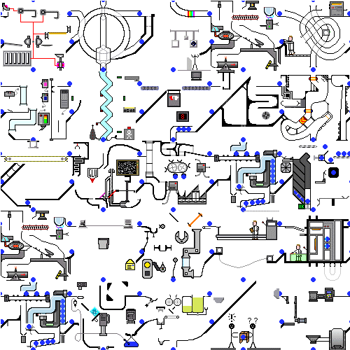
Top Reasons For Bugs
Notes:
miscommunication and changing requirements
time pressures
complexity of software

Slide 7
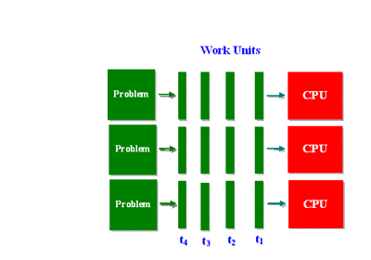

Changes in Computing
Notes:
hands on coding - architect?
OO and imperative - multicore and distributed

Slide 8
Can your language help?
You will write less, more meaningful code
You will write code faster
You will be more correct
You will have more fun
Examples:
Illegal State (null ref)
Broken Dependencies
System Complexity

Slide 9





What about Microsoft?
They care about selling … OS, MSDN (incl VS), Azure Time
Moving from C# to F# does not do that
C# is the gateway for Java Devs
F# is the Gateway for everyone else
Microsoft created some great things… that died
Microsoft created some dumb things… that survive

Slide 10
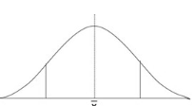
What About You? And Your Company?
F# is the lowest risk way to learn functional programming
F# is the lowest risk way to solve your current programming headaches
Example…

Slide 11
Questions
https://github.com/jamessdixon/hrug.mainmeeting.july2016
jamessdixon@gmail.com
@jamie_Dixon

